Slide 1



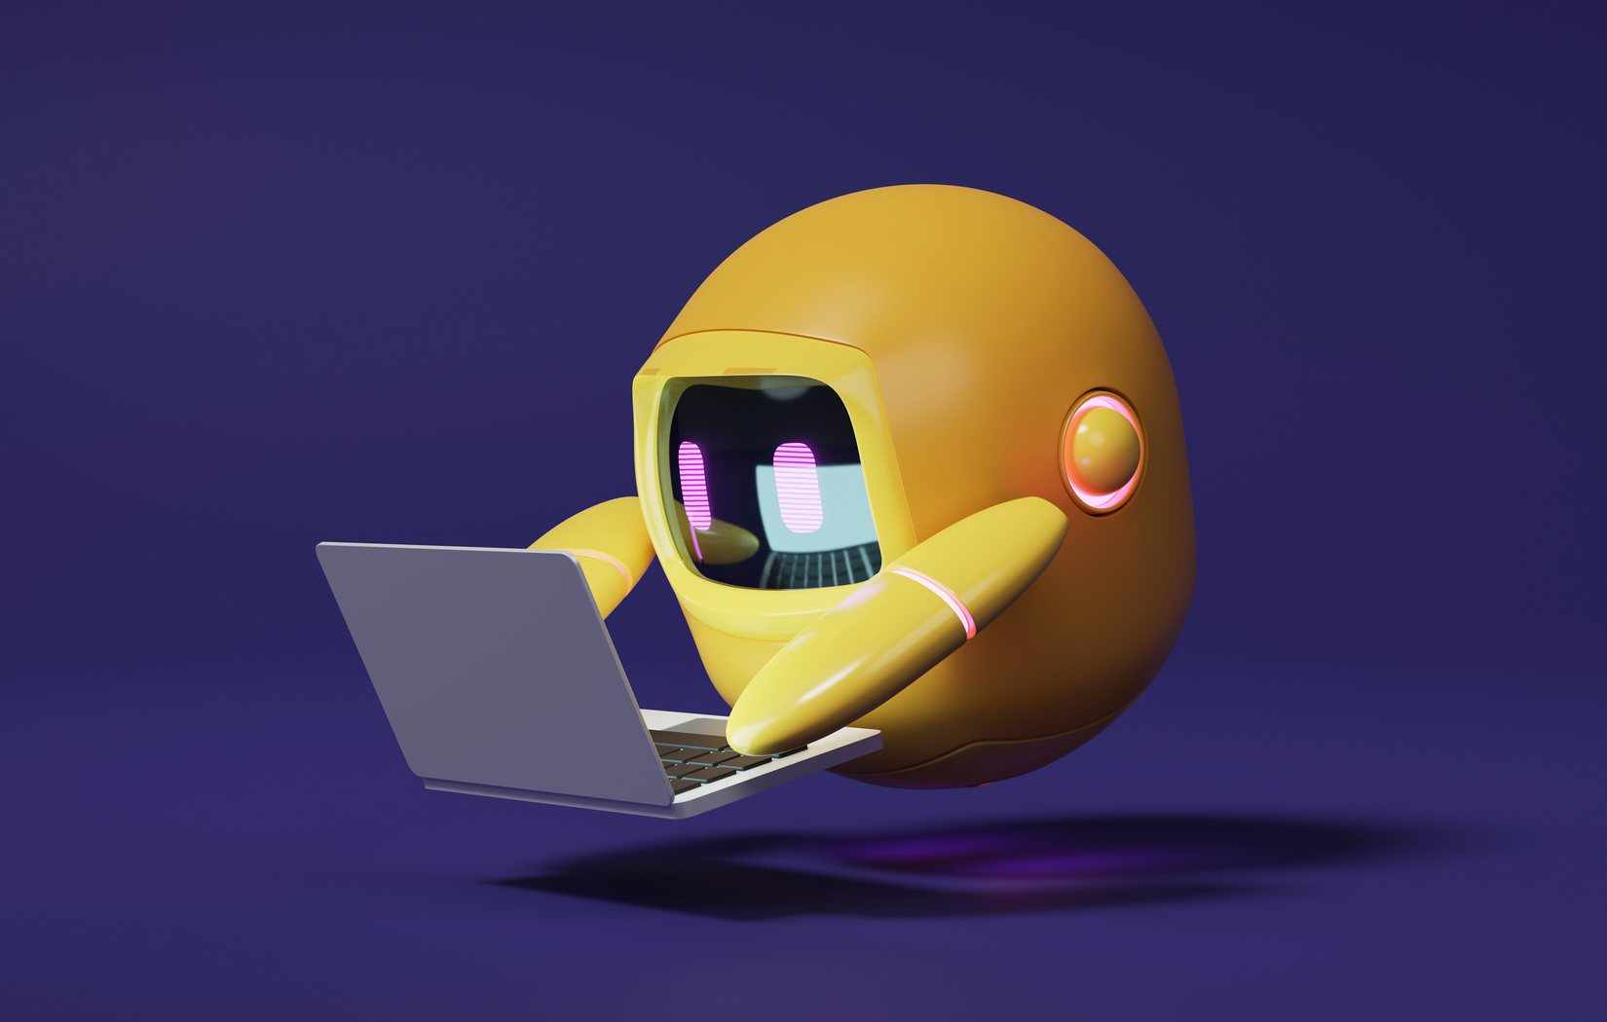

A 2-days National Level Hackathon on
Collaborative Bilingual Learning
Team name : Pixel master
Team Leader : Harsiddhi Pathak(backend developer)
Team member 1 : Garvit Panwar(python developer)
Team member 2 : Harish Rathore(frontend developer

Slide 2
PROBLEM STATMENT
Design a study buddy around one of these exams : JEE,NDA,CAT,GATE
Each Study Buddy Platform must include:
🗣 Bilingual Text + Voice Support (Hindi & English)
🎥 Multimedia Inputs (Text, Audio, Video, PDF)
🤝 Group Collaboration Tools (study rooms, chats)
🔗 MCP Integration for cross-device/platform compatibility
📈 Real-time Progress Tracking
Use of AI is mandatory – you can integrate models from OpenAI, Gemini, Whisper, Hugging Face, etc.

Slide 3
SOLUTION
Our proposed solution is the Study Buddy Platform, a collaborative learning application designed to overcome language barriers and support bilingual education. By integrating AI technologies, our platform provides real-time translation, personalized tutoring, and automated study material generation. It enables students to communicate and learn together effectively, regardless of their language background, making group study more accessible, engaging, and productive for everyone.

Slide 4
Approach
User-Centric Design: We focused on creating an intuitive and accessible interface for students of all backgrounds.
AI Integration: Leveraged AI for real-time translation, personalized tutoring, and automated content generation.
Multimedia Support: Enabled text, audio, video, and PDF inputs to enhance collaborative learning.
Real-Time Collaboration: Implemented group study rooms and chat features using Socket.IO for seamless Interaction.
Continuous Feedback: Incorporated progress tracking and analytics to help students and teachers monitor learning outcomes.

Slide 5
Methodology
Requirement Analysis: Identified key user needs and challenges in bilingual collaborative learning.
Technology Selection: Chose React, TypeScript, and Material-UI for frontend development, with AI APIs for intelligent features.
Modular Development: Built the platform in components for easy scalability and maintenance.
AI Integration: Connected external AI services for translation, tutoring, and content generation.
Testing & Feedback: Used automated tests and user feedback to refine features and ensure reliability.

Slide 6
Key features
Real-Time Bilingual Chat: Enables seamless communication in Hindi and English using AI-powered translation.
Personalized AI Tutoring: Offers tailored study support and instant answers to student queries.
Multimedia Input Support: Allows users to share and learn from text, audio, video, and PDF files.
Group Study Rooms: Facilitates collaborative learning with live chat and progress Tracking.
Automated Content Generation: Uses AI to create quizzes, summaries, and study materials for efficient learning.

Slide 7
Tech stack used
React – For building the user interface
TypeScript – For type-safe JavaScript development
Material-UI (MUI) – For modern, responsive UI components
Socket.IO Client – For real-time communication featuresi18next & react-i18next – For multilingual (bilingual) support

Slide 8
Expected outcomes
Improved Student Collaboration: Students can work together easily, regardless of language barriers.
Enhanced Learning Experience: Personalized AI tutoring and instant feedback boost understanding.
Greater Accessibility: Bilingual and multimedia support make learning inclusive for all.
Efficient Study Process: Automated content generation and progress tracking save time for students and Teachers.
Higher Engagement: Interactive features and real-time communication increase student participation.

Slide 9
Impact
Breaks Language Barriers: Enables students from different backgrounds to collaborate easily.
Boosts Academic Performance: Personalized AI support helps students understand concepts better.
Saves Time: Automates translation, tutoring, and content creation for faster learning.
Increases Engagement: Interactive features motivate students to participate Actively.
Promotes Inclusivity: Makes education accessible to all, regardless of language or learning style

Slide 10
THANK YOU
BY Team :- PIXEL MASTER

